Slide 1
AI-Driven Property Valuation: Optimizing House Sale Predictions
Hana Z. Hanifah, 26.02.2026

Slide 2
Why Automated Valuation Matters?
Manual Appraisal Bottleneck: Traditional house valuation is slow, subjective, and prone to human error.
Risk of Mispricing: Overpricing leads to stagnant inventory; underpricing leads to lost revenue.
The Need for Speed: In a fast-moving market, instant and reliable pricing is a competitive advantage.
Goal: Build a data-driven system to provide instant, objective price estimates.

Slide 3

Efficiency Through Automation
Process Overview:
Automated EDA: Instant identification of market trends and data anomalies (using YData Profiling).
Smart Feature Engineering: Automatically generating complex price drivers (e.g., house age vs. quality ratio) using Featuretools.
AutoML Orchestration: Testing 15+ algorithms simultaneously to find the most accurate model (PyCaret).
Impact: Reduced model development time from weeks to hours.

Slide 4
What Actually Drives Property Prices?
Living Area
Neighborhood Trends
Building Quality
Overall material and finish quality is the #1 predictor of value.
Total square footage remains a non-negotiable price driver.
Location-specific demand significantly shifts the baseline price.

Slide 5
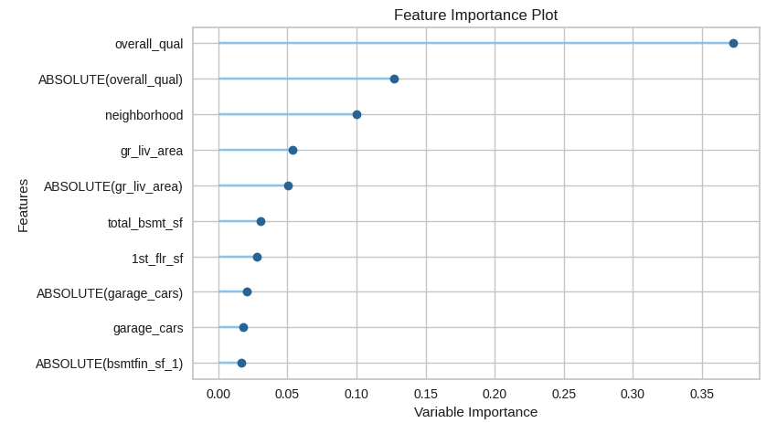
Notes:
The Feature Importance plot reveals that OverallQual and GrLivArea are the most influential variables in predicting house prices. This suggests that the market in Ames, Iowa, places a premium on the structural quality and the total living space.
Interestingly, automated feature engineering (using Featuretools) also highlighted that the age of the property relative to its last renovation is a key factor. From a business perspective, this insight allows us to advise sellers to focus on high-visibility quality upgrades (like interior finishes) to maximize their sale price, as these features have a higher weight in our predictive model than others.

Slide 6
Predictive Power (R² Score): 92%
Performance in Context (MAPE): 8.4%
Reliable Estimates with Minimal Deviation
Average Deviation (MAE): ~ $15,214
The Business Verdict:
The model successfully captures 92% of the factors influencing house prices, indicating extremely high reliability across different property types
With an average market price of $180,796, our margin of error stands at a low 8.4%.
On average, our automated price estimates only differ from the actual sale price by roughly $15k.
A sub-10% error rate is considered "Gold Standard" for automated valuation models (AVM). It provides a safe, data-backed foundation for instant quotes and initial negotiations.

Slide 7
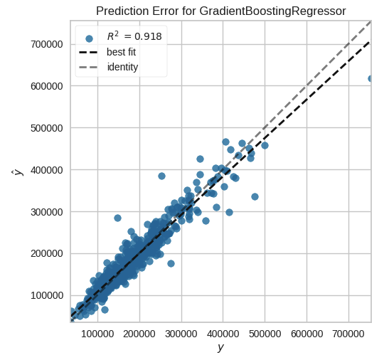
R² score = 0.92 (excellent confidence)
Avg. error = $15,214 (tight margin)
Percentage = 8.4% (Market Leading Accuracy)
Notes:
As shown in the graph, our Gradient Boosting model tracks actual sale prices very closely. The tightness of the points around the identity line proves our 92% R² score, meaning the model is ready for real-world deployment with high confidence.

Slide 8
Accelerated EDA:
Rapid Feature Discovery:
From Weeks to Hours: The Power of Automation
Model Benchmarking at Scale:
The Bottom Line:
Using YData Profiling/Sweetviz allowed us to identify data quality issues and market trends instantly, saving days of manual plotting.
Featuretools/Autofeat automatically tested thousands of feature combinations (like ratios of living area to total rooms) that a human analyst might overlook.
Instead of manually coding one model at a time, PyCaret allowed us to compare 15+ algorithms simultaneously to ensure we found the absolute best performer (Gradient Boosting).
Automation reduced the development lifecycle by roughly 70-80%, allowing the team to focus on interpreting results rather than writing repetitive code.

Slide 9
Transforming Insights into Business Action
Implementation: Integrate the model into our website to provide "Instant Valuation" for potential sellers, increasing lead generation.
Inventory Optimization: Identify "undervalued" listings in our database where the model predicts a higher price than the current listing, signaling a potential high-margin opportunity.
Standardized Appraisal: Use the AI as a "Second Opinion" for our human appraisers to ensure consistency across all regions and reduce bias.
Continuous Learning: Establish a feedback loop where actual closing prices are fed back into the model every month to adapt to shifting market trends.

Slide 10
Lesson Learned from an Automated Workflow
The Strength of Automation
The Necessity of Judgment
Conclusion
It is an incredible "force multiplier."
It explores the "breadth" of possibilities (many models, many features) much faster than a human can.
Automation is not a "Magic Box." Human intervention was still crucial for:
Data Cleaning: Ensuring the "Ground Truth" was accurate.
Business Context: Deciding that an 8.4% error is "good enough" for the business goal.
Automation doesn't replace the Data Scientist; it frees them to be more strategic.
We are moving from being "coders" to being "architects of insights.

Slide 11
Thank you!

